Slide 1
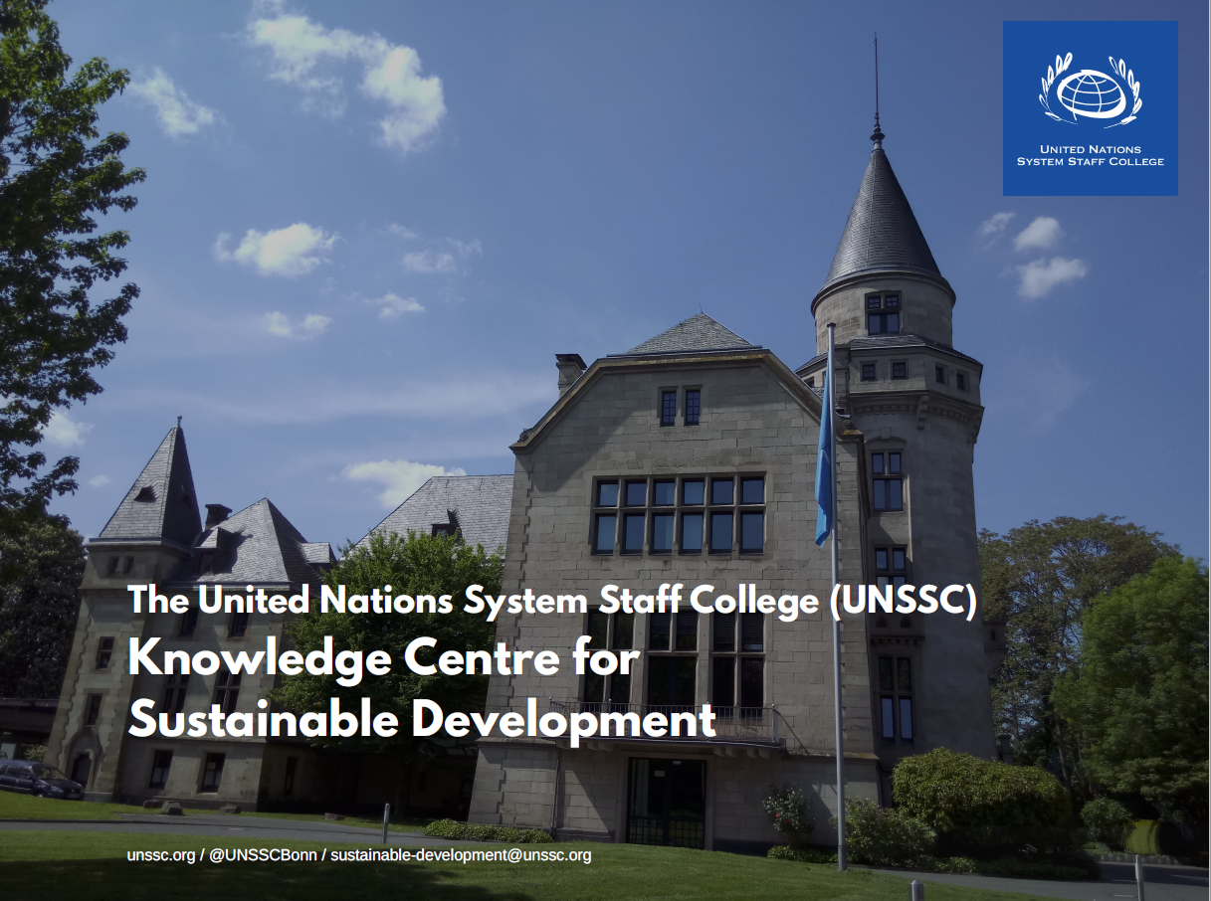
unssc.org / @UNSSCBonn / sustainable-development@unssc.org

Slide 2
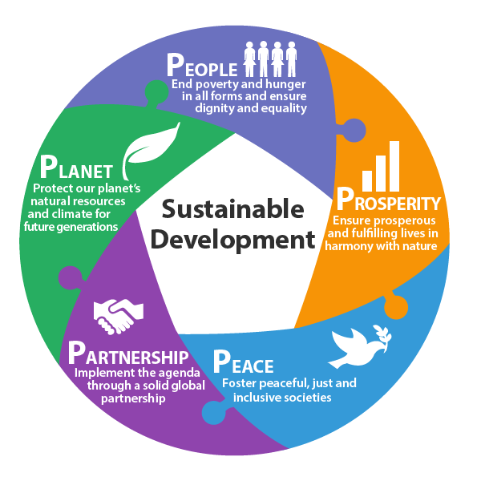

The 2030 Agenda: Five Critical Components

Slide 3

Re-capturing the narrative of sustainable development
@SimonaCostanzoS
Notes:
Partnerships should be led by goals and results, not by partners. The focus is on value added and synergy 1 + 1 = 3
UN as midwife

Slide 4
The purpose of a global development agenda is not to prescribe development strategies, but to provide guidance for priority setting!
Notes:
Is sustainable development the same as SDGs?
If not, how do we go about integrating the key messages of Agenda 2030 in our work?
National issues vs global issues (conflicts and climate beyond borders)
Strong emerging actors besides the UN (development banks, foundations, private sector, civil society)
Changing role and expectation of the UN: away from service delivery and institutional capacity building to more targeted expertise, facilitation of knowledge exchange and stakeholder engagement

