Slide 1
Os desafios da profissionalização na era das redes e das novas tecnologias
Virgilio Almeida
Harvard University
Universidade Federal de Minas Gerais
Junho de 2017

Slide 2
“The education system will need to adapt to prepare individuals for the changing labor market. At the same time, recent IT advances offer new and potentially more widely accessible ways to access education.” (report NAS, 2017)

Slide 3
Machines, it seems, can do almost anything human beings can.

Slide 4
Digital Future: What does it mean?

Slide 6
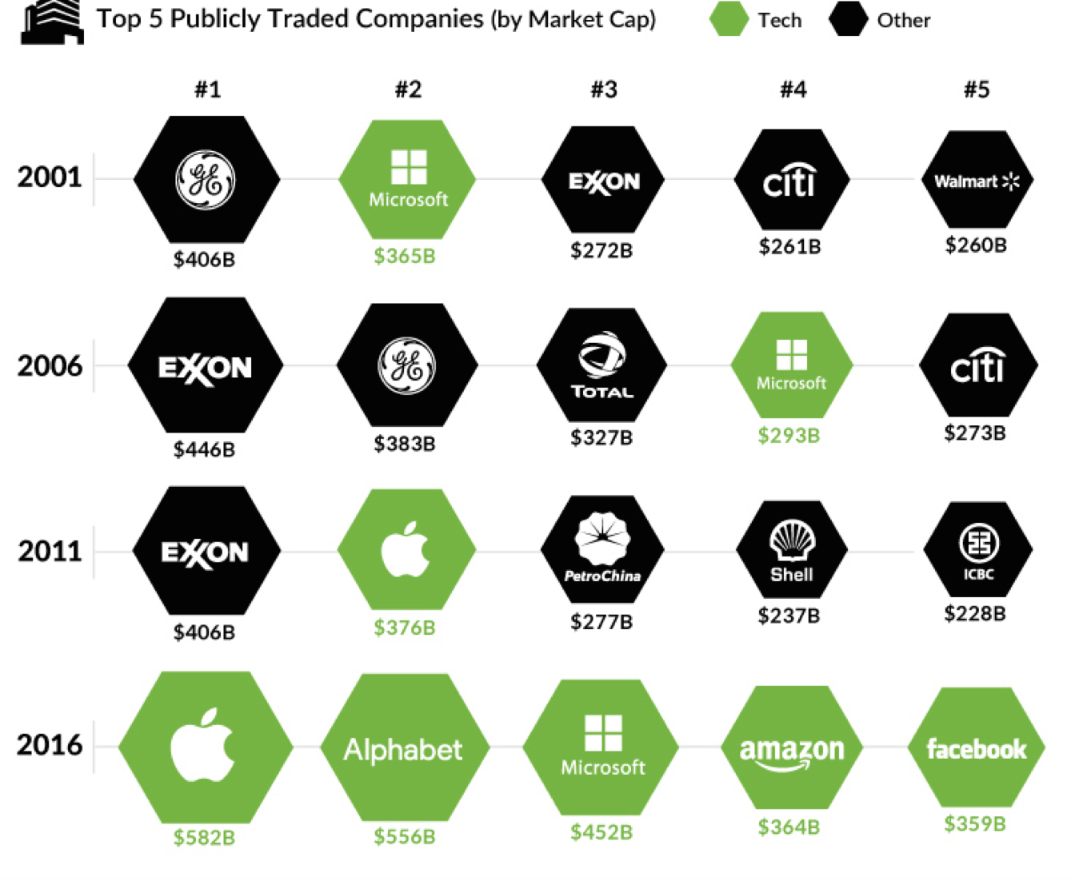
The Largest Companies by Market Cap

Slide 7
Jobs Shift

Slide 8
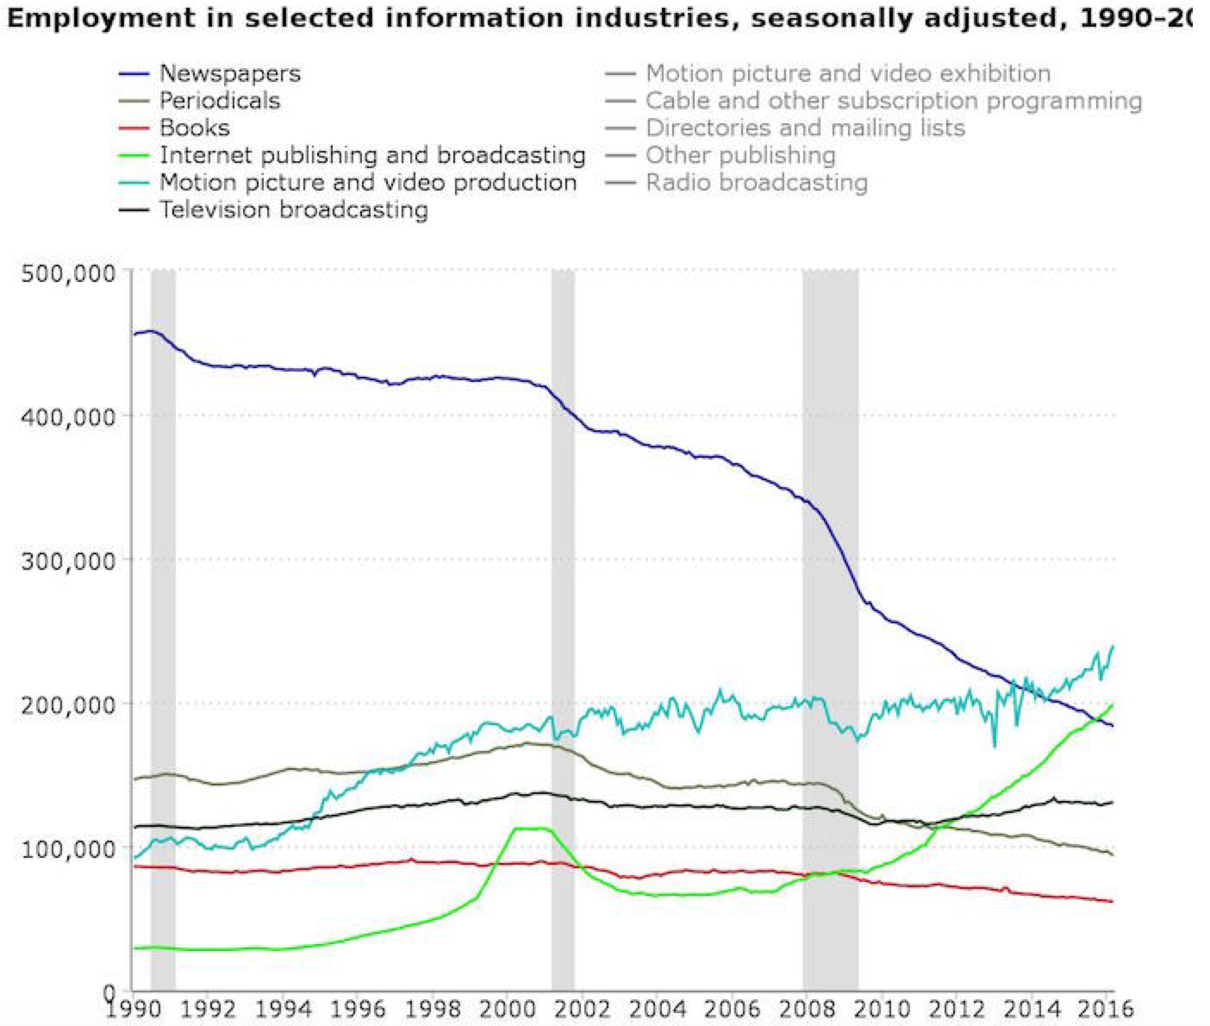
There are now more Americans working for online-only outlets than newspapers 1990-2016 (nieman lab)

Slide 10
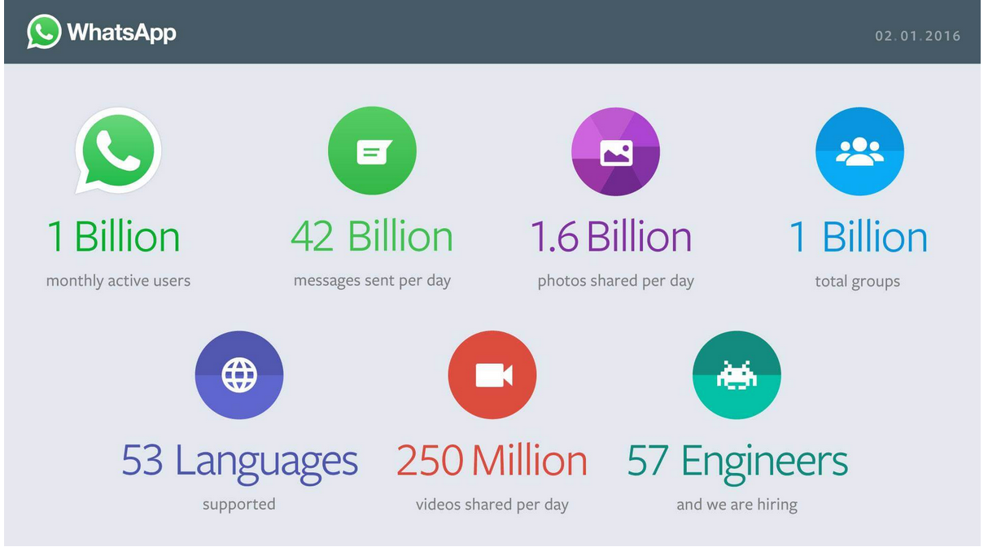

Slide 11
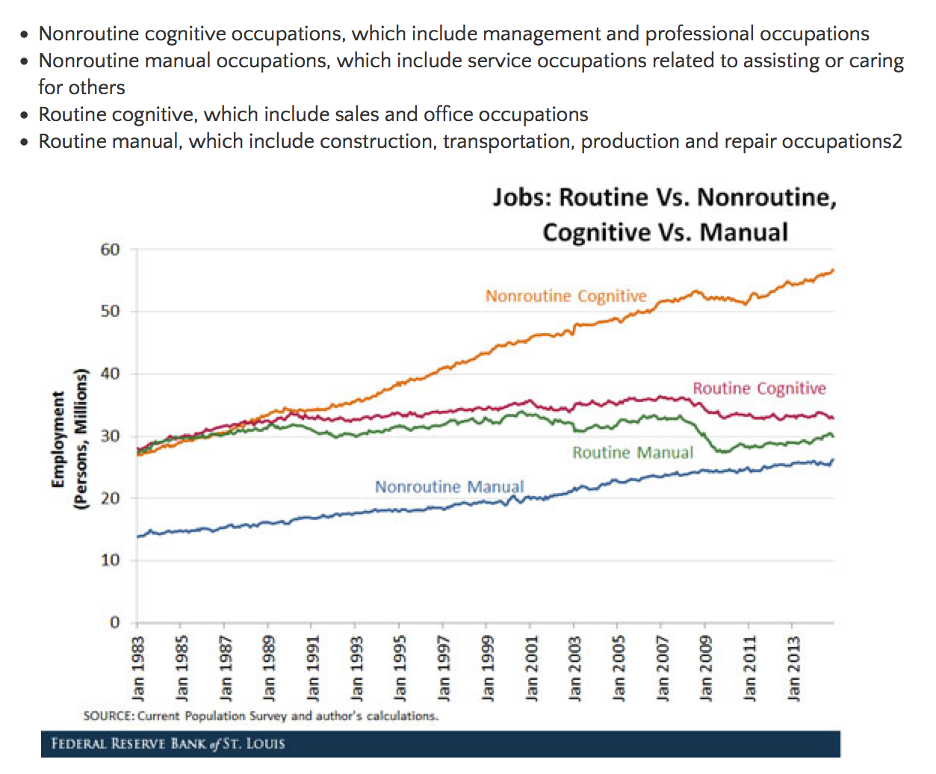

Slide 12
The Future of Jobs and Jobs Training
What are the most important skills needed to succeed in the workforce of the future?
Which of these skills can be taught effectively via online systems – especially those that are self-directed – and other nontraditional settings?
Which skills will be most difficult to teach at scale?
Will employers be accepting of applicants who rely on new types of credentialing systems, or will they be viewed as less qualified than those who have attended traditional four-year and graduate programs?
Source:
Pew Research

Slide 13
Major Themes about the future of jobs training in the tech age
Source:
Pew Research

Slide 14
Major Themes about the future of jobs training in the tech age
Source:
Pew Research

Slide 15
How to Prepare for the Digital Future
(algorithmic and automated future)
How do we educate people for an automated world?
Can we change education fast enough to outpace the demands of the digital future?
Will college degrees still be important?
What can workers do now to prepare?
Even if we do all these things, will there be enough jobs?

Slide 16
Thanks!
Valmeida@cyber.harvard.edu

Slide 17
Série de artigos recentes no Valor Economico
Virgilio Almeida
Desafios sociais e políticos da inteligência artificial
As novas faces do poder no mundo digital
O ``fator digital' nas eleições nos Estados Unidos E brasil
A escalada de conflitos e ataques cibernéticos no cenário internacional
O emprego e o futuro digital

