Slide 1
GOVERNANCE INDICATORS:
FROM Government at a glance TO Building Civil Service Capacity
21 June 2017

Slide 2
National schools of government priorities
What are your school’s priorities for the biennium?
Notes:
Addressing the challenges, delivering on priorities: similar to other public institutions, schools are under pressure to achieve more with less and demonstrate value for money
Recognising the importance of learning for effective public sector and the delivery on citizen expectations, Schools identify leadership development (in 80% of cases), promoting excellence in government services and policies (47%), alignment of civil service learning activities with the priorities of government (45%) and career development for new public servants (20%) as their priorities.
Some of the key challenges reported by the Schools include limited funding (67 %), insufficient qualified human resources (50%), uneven mechanisms for co-ordination with other civil service bodies (40%) and the need to enhance its monitoring and impact evaluation activities. In this context, Schools will need to find ways to become more cost-efficient, embrace innovation and modernise their approaches to learning.

Slide 3

What evidence do leaders need?
Comparative benchmarking
  How good are we doing?
  Do we need to do more?
Evidence-based decision-making
  Prioritisation
  Allocation
  What requires more attention?
  What works?
Inspiration
  How could things be done differently?
  Operationalising governance principles
  Understanding the implications of the data

Slide 4
Comparative benchmarking

Slide 5
SDG 16: Peace , justice and strong institutions
Target 16.7: ensure responsive, inclusive participatory and representative decision-making at all levels : “Proportion of positions ( by sex ….) in public institutions compared to national distribution”
Share of women in selected central government positions, 2015
Source: OECD (2016) Survey on the Composition of Employees in Central/Federal Governments

Slide 6
SDGs 16: Peace , justice and strong institutions
  Target 16.6: develop effective, accountable and transparent institutions at all levels : Proportion of population satisfied with last experience of public services
  OECD Serving Citizens framework:
ACCESS | RESPONSIVENESS | RELIABILITY/QUALITY
Affordability | Citizen centred approach (courtesy, treatment and integrated services) | Effective delivery of services and outcomes
Geographic proximity | Match of services to special needs | Consistency in service delivery and outcomes
Accessibility of information | Timeliness | Security ( safety)
In key public sectors including in the latest edition health care, education, and justice.

Slide 7
Serving Citizens – Scorecards
First attempt to compare across sectors!
Pillar 3:
Quality of Services
 | Top third group.
 | Middle third group.
 | Bottom third group.
Note: Countries are listed in alphabetical order. The number in the cell indicates the position of each country among all countries for which data are available. The arrows indicate whether the situation is improving (­↑), staying the same (→) or worsening (↓) in absolute terms (i.e. not relative to other countries). Years of reference for each indicator are specified in the figure notes. No symbol means no trend data available.
For detailed description of the indicators see "Chapter 14: Serving Citizens"

Slide 8
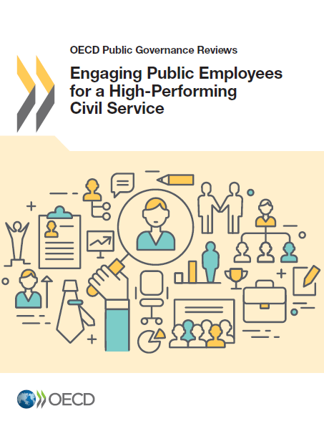
Engaging employees to improve governance outcomes
Engaged employees are “committed to their organisation's goals and values, motivated to contribute to organisational success, and are able at the same time to enhance their own sense of well-being”.
Research (mostly private sector) suggests that employee engagement supports:
  Profit: higher net income, operating margins, revenue growth, and shareholder value.
  Customer satisfaction: more satisfied & loyal clients, who actively promote service or product within their personal network.
  Productivity: higher job performance, efficiency, employee retention and wellbeing.
  Innovation: show more personal initiative, contribute more creativity to their work.

Slide 9
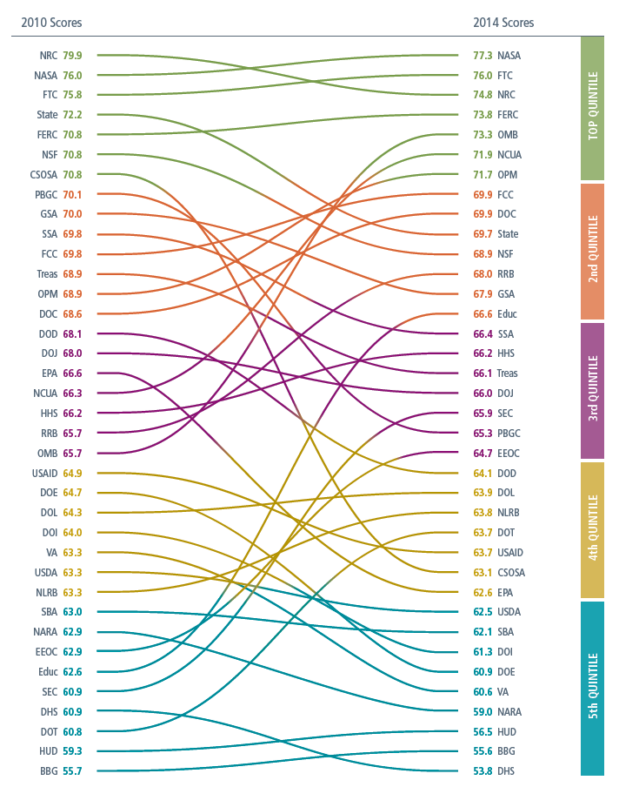
Data trends from the U.S. Federal employee viewpoints survey
 | 2010 | 2011 | 2012 | 2013 | 2014
Employee Engagement Index | 66 | 67 | 65 | 64 | 63
Leaders Lead | 55 | 56 | 54 | 53 | 50
Supervisors | 71 | 72 | 71 | 70 | 71
Intrinsic Work Experience | 72 | 72 | 71 | 69 | 68

Slide 10
Evidence based decision making

Slide 11
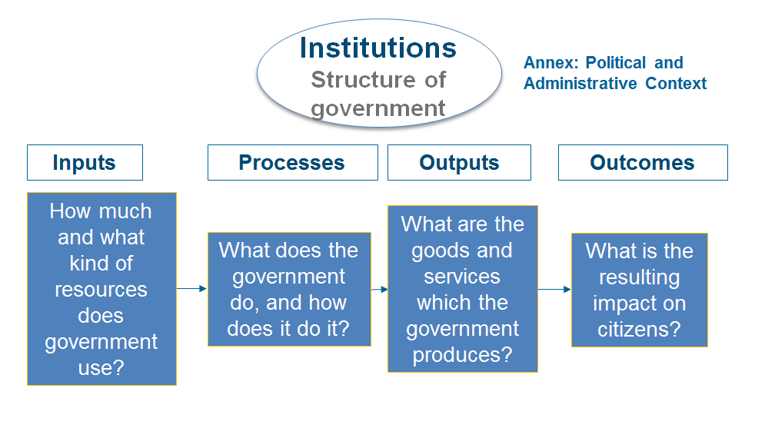
Data and Research: The G@G framework
Notes:
Milestones:
First edition in 2009 : focus on inputs and processes
Second edition in 2011: outputs and outcomes are added
Key strength in documenting governance processes in member countries and beyond
Regional editions

Slide 12
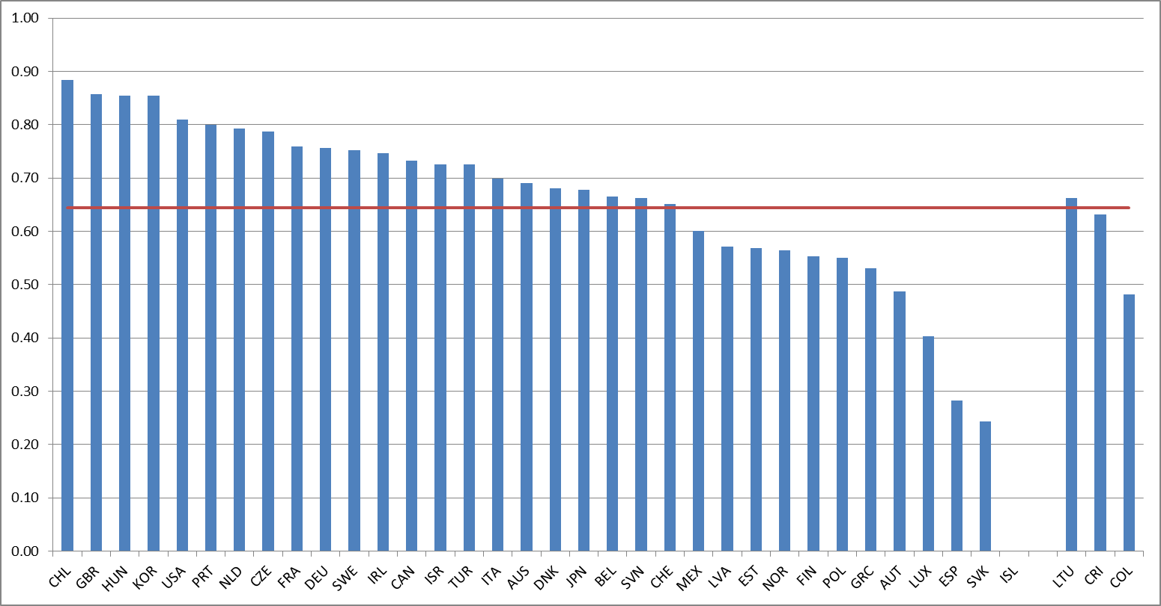
Extent of the use of performance assessments in HR decisions in central government, 2016
Source: OECD (2016) SHRM – Preliminary findings
Notes:
Data for New Zealand not included in the OECD average (NZ responses: Not able to answer. Decentralised model. Not possible to tell)
Gaag 2011: “Data for Luxembourg, New Zealand and Slovak Republic are not available”
Iceland does not have formalized performance assessment mandatory for government employees
Indicator changed since 2010. The following items were removed: Meeting w/superior 2 levels above or HR officer ; other tools for performance assessment; Activities undertaken; Timeliness of activities undertaken; Timeliness of outputs; Cost-effectiveness of outputs' production; Quality of outputs; other performance criteria.
Questions:
Q49 [Q61] Is formalized performance assessment mandatory for all government employees? (Yes for all or almost all; No only for some; No not used at all)
Q50 [Q63] Which tools are used for regular performance assessment and how often are they applied? (Meeting w/ immediate superior, Written feedback from superior, 360 feedback)
Q51 [Q64] What are the current performance criteria explicitly used in most organisations? (Outputs / achievement of objectives; Improvement of competencies; Values, discipline and inputs; Interpersonal/management skills)
Q54 [Q67] How important, according to legal criteria, is having a good performance assessment with regard to (career advancement, remuneration, contract renewal)

Slide 13
Performance budgeting –
A tool for accountability & transparency
Use of performance budgeting practices at the central level of government (2013)
Source: OECD (2014) Government at a Glance Latin America and the Caribbean

Slide 14
Adopting a culture of evaluation
Adoption of RIA: Formal requirements and practice (2015)
Source: OECD Indicators of Regulatory Policy and Governance (iREG) for Latin America 2016; OECD Indicators of Regulatory Policy and Governance (iREG) 2015, www.oecd.org/gov/regulatory-policy/indicators-regulatory-policy-and-governance.htm
Source: Government at a Glance Latin America and the Caribbean 2017

Slide 15
Adopting a longer term perspective in budgeting
Time spam of long-term fiscal budgetary projections (2013)
Better coordination
Discussion of a broader policy agenda
Identify probable future challenges that could affect economic conditions in the future
Source: Government at a Glance Latin America and the Caribbean 2017

Slide 16
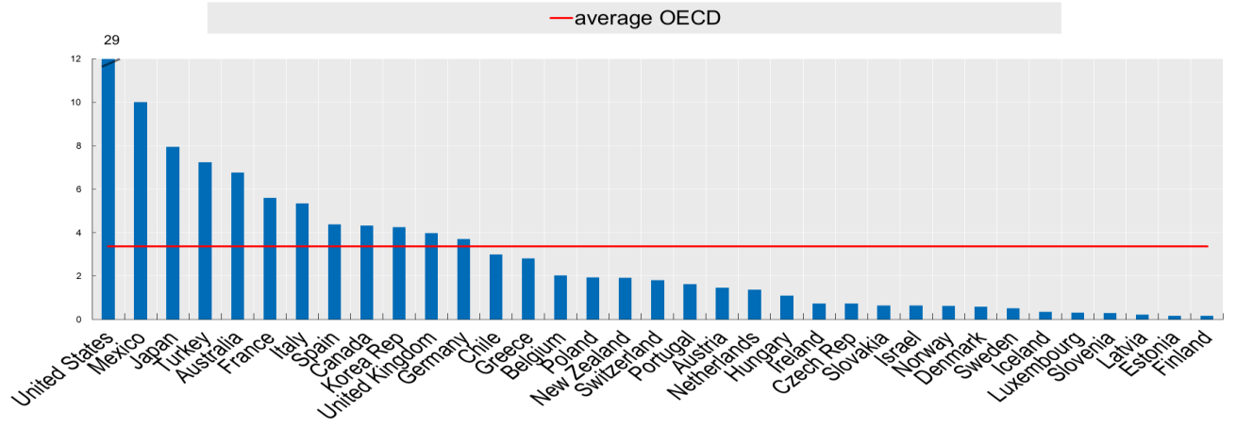
Risk governance and communication –
Policy design, evaluation and engagement
Average number of disasters per year across OECD countries, 1980-2016
Existence of a national strategy with an all hazards approach for the management of critical risks, 2016
Source: OECD (2016), Survey on the Governance of Critical Risks

Slide 17
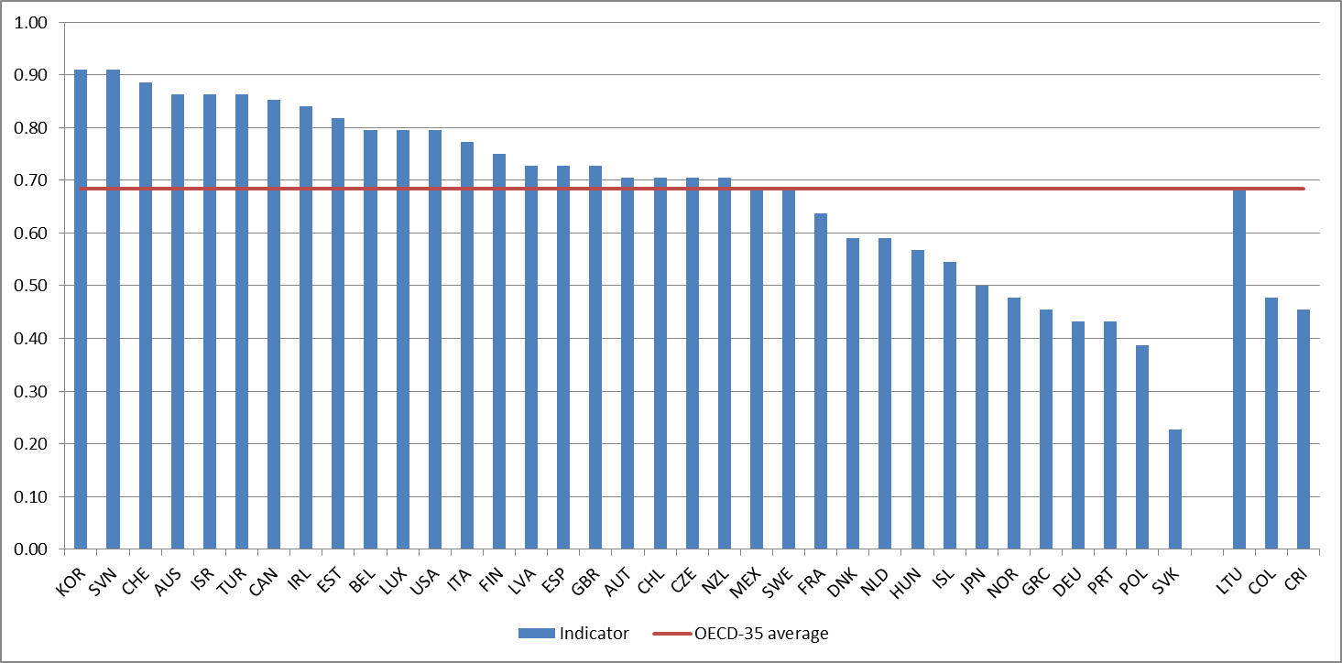
Collection of HR administrative data in central government, 2016
Source: OECD (2016) SHRM – Preliminary findings
Notes:
New indicator.
The index measures the existence of the following administrative data records at the Central/federal level:
number of employees; level; function; age; gender; disabilities; other minority status; level of education; length of service; languages spoken; type of contract; union membership; part time; other flexible working arrangements; total sick days used; training days used; special leave used; mobility within the civil service; turnover data; retirements; resignations; dismissals. Responses to individual variables consider the following options: 1 (Yes, standardized data records are available and are centralised for the whole or most of the national/federal civil service); 0.5 (Yes, however standardized data records only exist at line ministry level, ie not aggregated centrally) and 0 (No, currently no standardized administrative data record exists).

Slide 18
OECD OURdata Index: Open, Useful, Reusable Data
Notes:
Fresh index!
Data for the LAC OURdata index were collected in 2016, with the exception of MEX and CHL (both 2014, included in OECD ourdata index)
13 countries replied, 3 don’t have a portal (so therefore we can’t calculate an index). We are still validating some aspects of the data with Paraguay therefore it is for now excluded from the index.
Noteworthy: Colombia is a (the only) country we have two data points for: one in 2014 and one 2016, showing progress, especially on the availability dimension!
On the Southeast Asian Government at a Glance we have not collected any data yet. However, as part of the SEA G@G initiative we will start collecting as of November 2016 data on OGD in ASEAN countries (including Cambodia, Indonesia, Lao PDR, Malaysia, Philippines, Singapore, Thailand and Viet Nam). We will use the latest version 3.0 of the OGD survey which we presented in a workshop in Thailand 2 weeks ago. The data should be ready in the fall 2017.

Slide 19
Inspiration

Slide 20
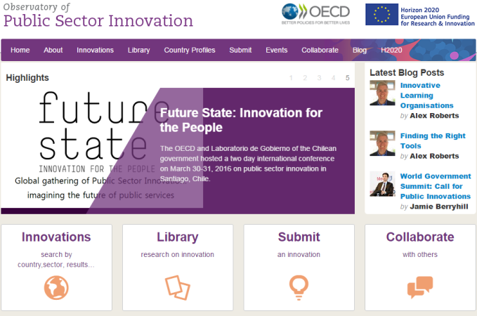


The Observatory of Public Sector Innovation
Source of information
  More than 400 case studies of public sector innovation projects
  Developing partnerships with EPSA, ENAP (Brazil) and Harvard Kennedy School to bring hundreds more in 2017
Advisory unit
  Practical advice on how to make innovation work in the public sector
  Latest research in innovation knowledge and practice
  Important innovation events, resources, and publications
Practitioner community
  Bringing together public sector innovation experts from across OECD member and partner countries
  Sharing experiences and collaborating on new approaches and ventures, peer support to work through challenges

Slide 21
Public sector innovation included in...
Source: OECD (2016) SHRM

Slide 22
Is there an award to promote public sector innovation in the civil service?
If yes, how are the innovations used?
Source: OECD (2016) SHRM

Slide 23
ARE THERE ANY INNOVATION NETWORKS ACROSS THE CIVIL SERVICE?
The networks are mainly supported by:
Central HRM Unit (6)
Central innovation institution (3)
National School of Government (3)
Informal network/ supported independently (10)

Slide 24
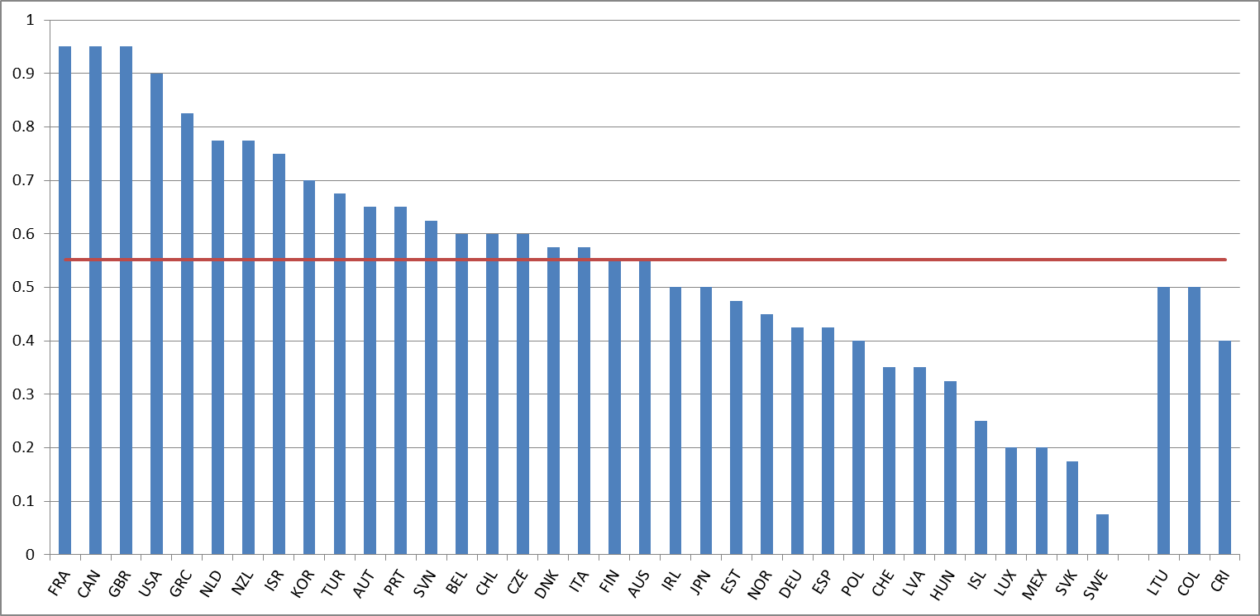
Many OECD countries are investing in leadership
Use of separate HRM practices for senior civil servants in central government, 2016
Source: OECD (2016) SHRM – Preliminary findings
Notes:
Data comes from Strategic Human Resources Management (SHRM) survey, 2016
13 topics including new areas (innovation, data collection, learning), ~ 130 questions
5 composite indicators (senior civil service, delegation, performance assessment, performance-related pay, data collection)
All OECD countries + accession

Slide 25
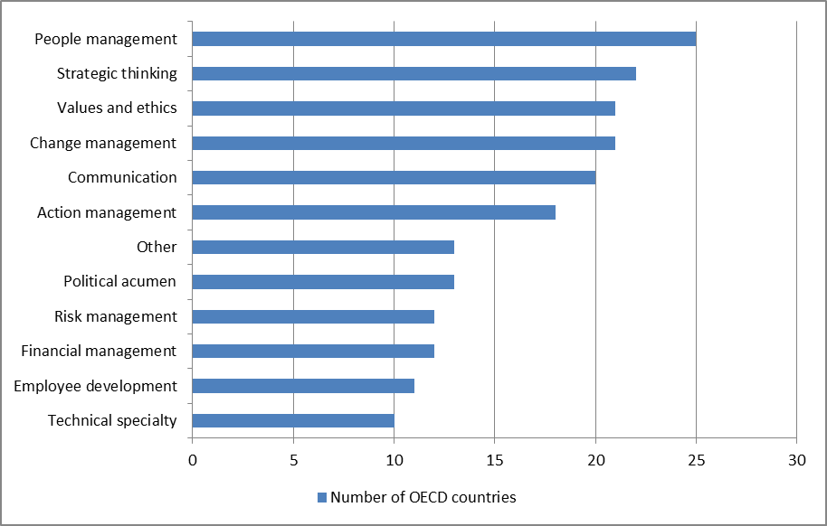
What kind of leaders are they looking for?
Competencies valued in the Recruitment and development of Senior Management (2016)
Source: OECD (2016) SHRM

Slide 26
SIX CORE SKILLS AREAS FOR
PUBLIC SECTOR INNOVATION
Iteration
Rapid and incremental development
Developing and refining prototypes
Experimentation and testing
Challenging the usual way of doing things
Working with unusual/ different partners
Building alliances for change
Insurgency
Data literacy
Basing decisions on data and evidence
Building systems that collect the right data
Communicating data effectively
Storytelling
User centred
Using narratives to explain 'the journey'
Including 'user stories' to outline benefits
Progressing the story as situations change
Policies and services solve user needs
Considering users at every stage
Users that say: "I would do that again"
Curiosity
Identifying new ideas, ways of working
Adapting approaches used elsewhere
Reframing problems and perspectives
Notes:
Last year we worked together with the NCP on refining the skills framework for innovation in the public sector and this is where we have gotten it to… [describe]

Slide 27
Innovation skills in Chile’s public sector
Notes:
Key gaps:
IT1 Iterative project management
IT3 Experiments
UC5 Behavioural insights

Slide 28

Objectives of the OECD Network of Schools of Government
Supporting countries in securing long-term sustainability of public sector reforms through:
Strengthening the link between international policy dialogue and national public service capacity-building efforts;
Informing the OECD policy dialogue with lessons and good practices on implementation on the ground; and
Supporting exchange among national schools of government on current policy priorities and capacity-building, policy implementation and research needs.
“National Schools of government: Building Civil Service Capacity” (2016 Report)
Objective: to support policy dialogue across OECD and partner countries on the role of the Schools of Government in 1) shaping and supporting the implementation of the governmental agenda ; 2) developing necessary skills of public servants to respond to government priorities and citizen expectations.
Notes:
The OECD Network of Schools of Government is a world-wide network of schools of government, research and training institutions that serves as a consultative and knowledge diffusion body for the work of the OECD Public Governance and Territorial Development Directorate.
Established in 2014, the Networks counts now some 87 member institutions from 51 countries, including Russia (RANEPA), CIS-countries (Belarus, Kazakhstan, Ukraine).
The Network provides direct access to OECD governance expertise, and allows schools to exchange experiences and good practices in ensuring that public sector employees have the skills and competencies to address current and future priorities.

Slide 29
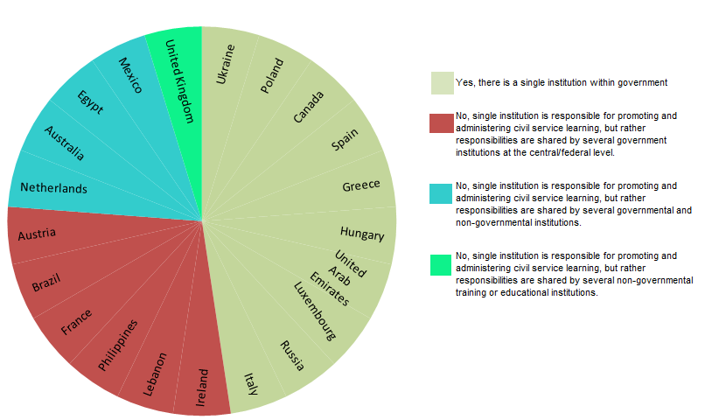
Key findings: Learning arrangements in the civil service
Is there a single institution responsible for co-ordinating, promoting and administering learning for civil servants in your country at the central/federal level of government?
Notes:
In most respondent countries, a single institution within government is responsible for co-ordinating, promoting and administering learning for civil servants (the respondent school).
When that is not the case, responsibility is usually shared between several governmental institutions at the central/federal level.
Both governmental and non-governmental institutions share responsibility in four respondent countries: Netherlands, Australia, Egypt and Mexico.
Government is not involved in co-ordinating, promoting and administering learning for civil servants in the UK; this is handled entirely at the non-governmental level.
Greater mandate clarity and strengthened institutional framework for learning and development would be beneficial to drive high Schools’ performance.
Effective schools’ governance and management are critical to ensure relevance of their programmes to government priorities and civil service capacity needs
While all participating countries reported having in place an institution responsible for civil service learning, they differed in their institutional form, mandate, autonomy and relationship to government and non-governmental stakeholders.
The internal Schools’ governance and management models reflect a variety of factors such as the civil service model, Schools’ legal structures, institutional model (i.e. academic versus public administration), relationships or partnerships with other institutions. While most Schools operate under an institutional head, some have also established a board of directors/trustees (20% of respondents) and a council of members (27% of respondents) as the main governance or management bodies to separate the division of duties between day-to-day administration and strategy-setting.
All respondents were established through a form of legal instrument, although further clarity of mandates, roles and responsibilities would be beneficial.

Slide 30
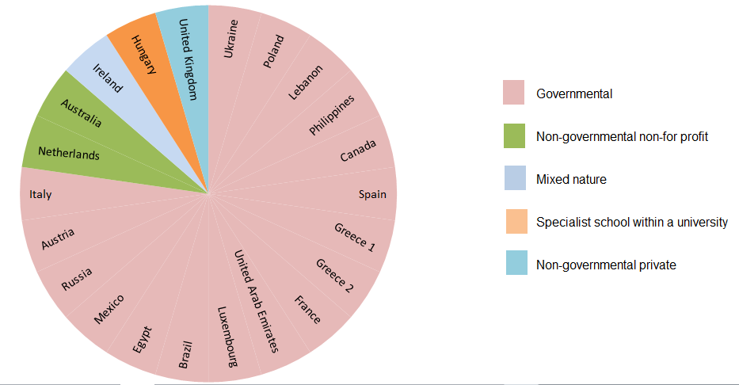
Key findings: learning arrangements in the civil service
Type of institutions
Notes:
Respondent schools are mostly affiliated with the government, independently of the number of institutions responsible for co-ordinating, promoting and administering learning for civil servants.
Greater mandate clarity and strengthened institutional framework for learning and development would be beneficial to drive high Schools’ performance
While all participating countries reported having in place an institution responsible for civil service learning, they differed in their institutional form, mandate, autonomy and relationship to government and non-governmental stakeholders.
The internal Schools’ governance and management models reflect a variety of factors such as the civil service model, Schools’ legal structures, institutional model (i.e. academic versus public administration), relationships or partnerships with other institutions. While most Schools operate under an institutional head, some have also established a board of directors/trustees (20% of respondents) and a council of members (27% of respondents) as the main governance or management bodies to separate the division of duties between day-to-day administration and strategy-setting.
All respondents were established through a form of legal instrument, although further clarity of mandates, roles and responsibilities would be beneficial.

Slide 31
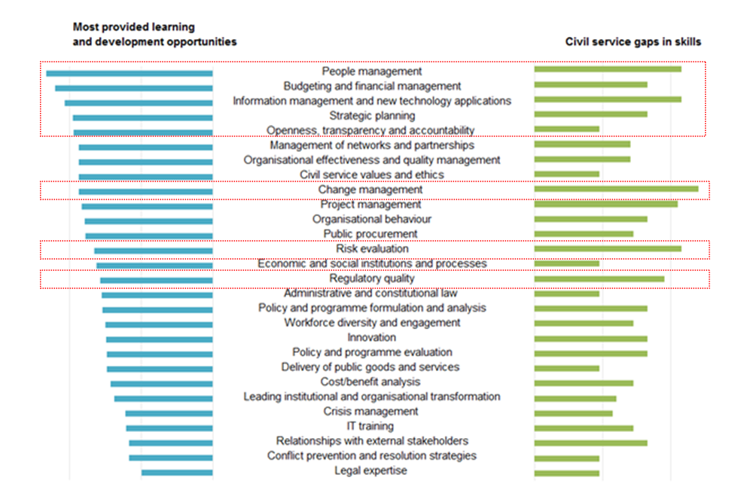
Key findings: alignment between the top ranked learning areas and gaps in skills
Notes:
Schools of Government are increasingly innovating in their programmes. Innovation and quality assurance in learning programmes are essential to ensure their responsiveness
While most survey respondents indicated a preference for traditional classroom training, other teaching methods, such as team-based activities and study tours are increasingly being used (in about 50% of cases). Importantly, while still a minority, approximately 40% of Schools of Government are providing training to civil servants in the form of online self-study courses. There is also a growing trend of combining several training methods (e.g., executive training may integrate classroom teaching with peer-and in-service learning).
There seems to be a general alignment between the top most ranked learning areas offered by Schools of Government and the potential skills needs in civil services. Although some disparities exist, people management, ICT applications, change management and project management are the areas highly ranked as both learning offerings and skills needs. At the same time, while risk evaluation, programme evaluation, innovation, stakeholder engagement and policy analysis have been identified among the areas with greatest skills gaps across civil services, learning offerings in these areas generally appear to be scarce.
Over half of respondents (18 out of 23) indicated that they are engaged in knowledge development and research, especially applied research and primarily in the areas where Schools provide training and development programmes (with the exception of information technology, project management and administrative law).
The top priority themes for teaching in the respondent schools are: leading institutional and organisational transformation; organisational effectiveness and quality management; policy and programme formulation and analysis (one of the biggest identified gaps); people management (ditto); and, at an equal level, administrative and constitutional law (one of the smallest identified skill gaps); delivery of public goods and services (one of the biggest identified gaps); and budgeting and financial management.

Slide 32
Key findings: Modes and methods of evaluation of national schools of government activities
As your school monitors and evaluates its activities, how does it monitor and evaluate their impact?
Notes:
Further investments are needed to advance monitoring and evaluation for enhanced impact and relevance of Schools of Government’s programmes.
Monitoring and evaluation is an essential but underutilised tool
Most Schools of Government have put in place evaluation and monitoring mechanisms for their learning programmes, although most of these are internally managed and carried out using traditional methods. Further investment in independent evaluations and in measuring the impact of training on behavioural changes will be important to ensure ongoing relevance and effectiveness of learning programmes.
While most of the Schools of Government report actively evaluating their learning programmes, only 14% of them conducted evaluations of their research activities. As research activities are also subject to demonstrating their value for money, this may also prove to be an area in which Schools may need to undertake further investments.

Slide 33
G@G 2017 – Table of Contents
Inputs
Processes
Outputs and outcomes
4. Institutions
5. Budget practices & procedures
6. Human Resource Management
7. Public sector integrity
8. Regulatory governance
9. Public procurement
10. Open government
11. Public sector innovation and digital government
12. Risk management & communication
2. Public finance & economics
3. Public employment & compensation
13. Core government results
14. Serving Citizens
Notes:
Objectives of the Gag:
Provide internationally comparative data on how governments work and their performance
Allow countries to benchmark their own performance
Improve public governance in countries

Slide 34
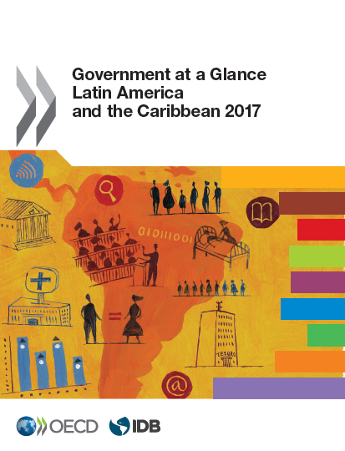
Government at a Glance: Latin America and the Caribbean 2017
Second edition, 2014 and 2017
Joint effort between the OECD and IDB
Based on the OECD methodology
Comparative perspective (within the region and to the OECD)
It includes on average 15 LAC countries
Contributed to the creation of policy networks in the region
Public finances and economics
Public employment
Centres of Government (CoG)
Budget practices and procedures (health budgeting)
Human resources management
Regulatory policy and governance
Open and digital government
Public procurement
Policy chapter (the effects of fiscal policy in equity)
Notes:
Areas highlighted in yellow are new to the second edition
New policy networks, (e.g. health systems joint ELS/GOV network meeting, OECD LAC network on regulatory governance)
Focus of the 2017 edition: Strengthening public governance requires the development of public sector capacities
Budgeting and fiscal institutions
Human resources management
Open and Digital government
Regulatory governance and policy

Slide 35
Thank you!
www.oecd.org/gov/govataglance.htm

