Slide 1
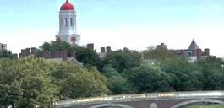
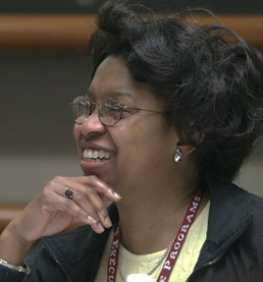
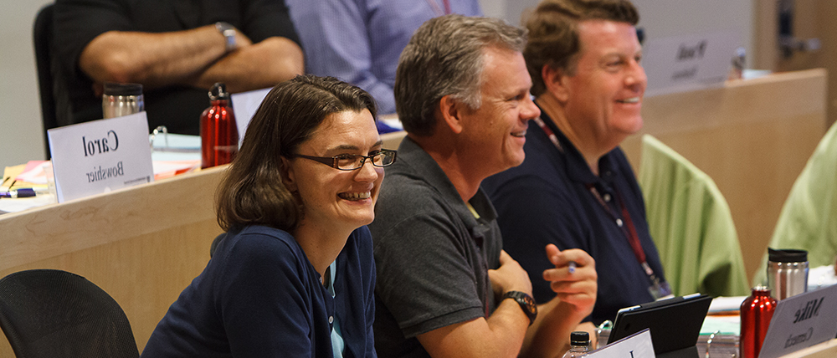
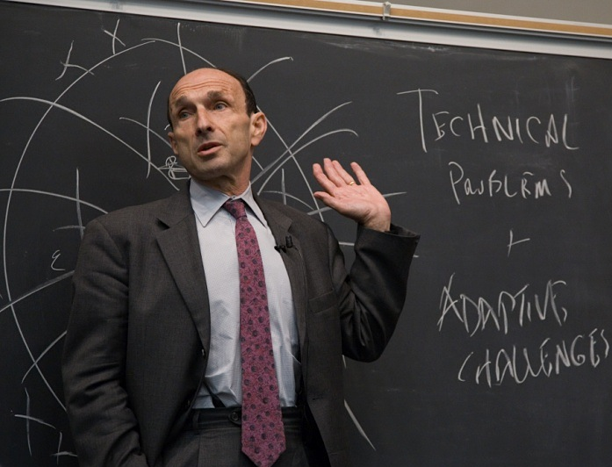
LIFELONG LEARNING
LIFELONG IMPACT
Training for the civil service - an international perspective
Debra Iles
Senior Associate Dean for Executive Education
Harvard Kennedy School
June 20th 2017
www.hks.harvard.edu/execed

Slide 2
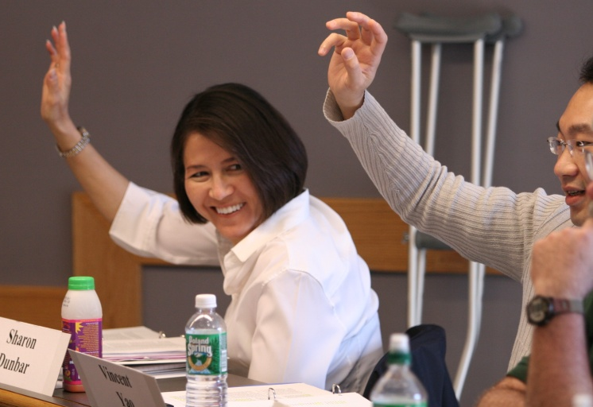
Mission of the Harvard Kennedy School
Train enlightened public leaders and generate ideas that provide answers to the world’s most challenging public problems.
Notes:
There are three areas in the school that support the Harvard Kennedy School Mission.
Today the school has 25 research centers and programs, 42 executive education programs, 5 degree programs, 900 full time degree students and 3000 Executive Education participants each year.
The school strives to combine scholarly excellence with genuine impact by actively fostering the collaborative efforts of scholars, public officials, and others who are vitally concerned with the public good.
Degree programs
Train the next generation of public leaders
Focus on analytical reasoning
Art and science of politics and public management.
Executive Education
Train current leaders
Programs enhance the knowledge, skills, and perspectives of current practitioners.
Research Centers:
Harvard Kennedy School is home to many world-class research centers, programs, and initiatives including, but not limited to:
Ash Institute for Democratic Governance and Innovation
Belfer Center for Science and International Affairs
The Center for Public Leadership
Malcolm Wiener Center for Social Policy
Mossavar-Rahmani Center for Business and Government
Center for International Development

Slide 3
Programs at Harvard Kennedy School
“Leadership and learning are indispensable to each other.”
John F. Kennedy
Master in Public Policy
Master in Public Administration
Executive Education certificate programs
More than 50% international; students from all over
the world – representing 140 countries
900 Masters students
4000 people in 70+ Executive Education programs
each year, most 1-2 weeks long.
Notes:
General Harvard University overview
Additionally mention:
Other schools within the University – Harvard Law School, Harvard Business School, Divinity School. Graduate School of Education, etc.
Harvard Kennedy School is the school within Harvard University dedicated to Public Policy and Administration.

Slide 4
Professional Development for the Civil Service
Unique needs of the public sector
The impact of rapid changes in technology
Leadership development challenges
Managing changing demographics
Notes:
There are many advantages to participating in an Executive Education program at Harvard Kennedy School.
Our programs have often been described as “transformative experiences.”
We’ve found that the best people to describe it are our Alumni.
Our alumni tell us that the lessons they took away from the classroom can be put into use immediately for both personal and professional challenges and the ability to call upon fellow classmates, faculty members and other HKS resources made their executive education experience priceless.

