Slide 1
Public Governance at the OECD HIGHLIGHTS AND INSIGHTS for BRAZIL and LAC
Luiz de Mello
Deputy Director
Public Governance
Rio de Janeiro, 21 June 2017

Slide 2
Roadmap
A primer on the OECD
Key facts and numbers
Why does public governance matter?
How we support policymakers
How do we support policymakers?
Our tools and lines of work

Slide 3
The OECD: Key FACTS and Numbers

Slide 4
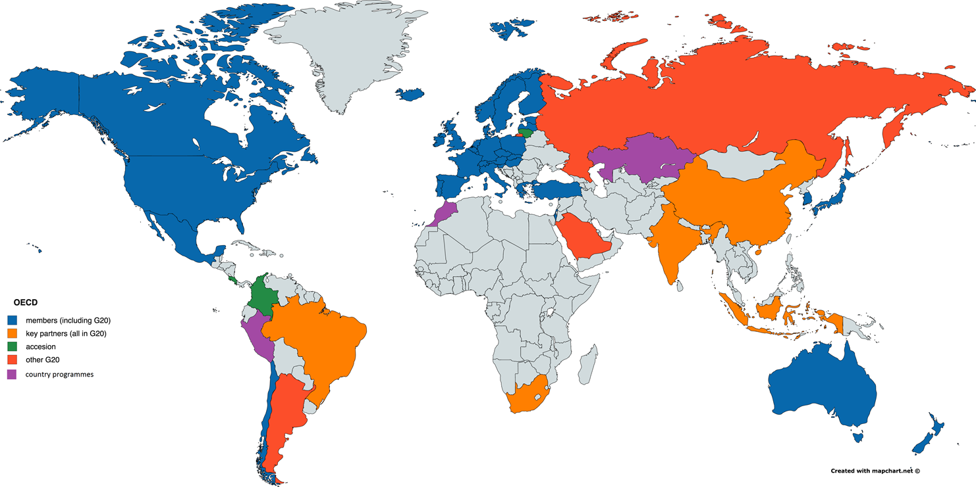
More than just “developed countries”, …
1961
1974
1994
2007
2008
2013/15
2014

Slide 5
… and a large presence in the world
35
€370 Million
(2016)

Slide 6
Brazil and the OECD: A growing and mutually beneficial cooperation
Brazil
South Africa
India

Slide 7
Why does public governance matter?

Slide 8
Government accounts for a large share of the economy, not only in terms of production, …
Source: OECD National Accounts and Government at a Glance databases.

Slide 9
… but also employment in most countries
Employment in public sector as a percentage of total employment
Source: International Labour Organization (ILO) ILOSTAT (database).

Slide 10
Quality, not only the level, of spending affects performance
Source: PISA 2012 Results: What makes schools successful? Resources, policies and practices, Volume IV.

Slide 11
Regulation is a powerful tool, but few countries systematically evaluate its impacts
OECD average
EU average
Note: The vertical axis represents the total aggregate score across the four separate categories of the composite indicators. The maximum score for each category is one, and the maximum aggregate score for the composite indicator is four. The EU average is for the 21 EU member countries that were also members of the OECD at the time of survey in 2015.
Source: OECD (2015), OECD Regulatory Policy Outlook 2015, http://www.oecd.org/gov/regulatory-policy/indicators-regulatory-policy-and-governance.htm.

Slide 12
Integrity matters not only for confidence in government and institutions, …
2104

Slide 13
… but also for economic performance
Innovation Index (WEF)
Source: Data available from WEF and Gallup World Poll.

Slide 14
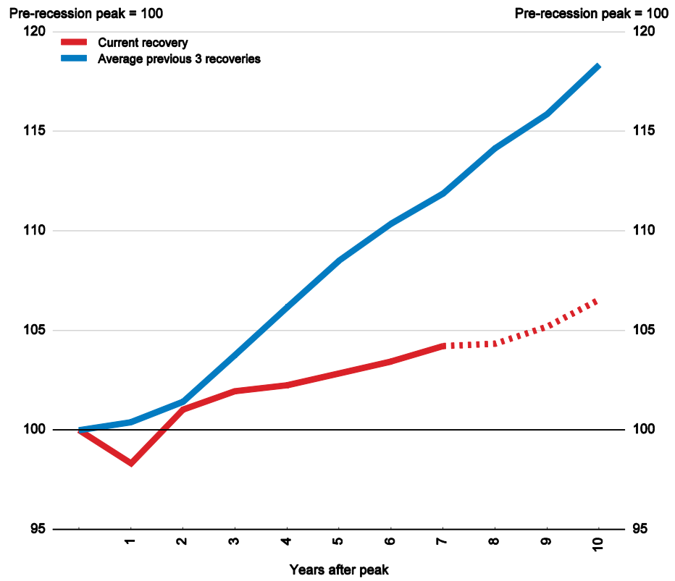
A few challenges remain; productivity growth has been slower than in the past, and …

Slide 15
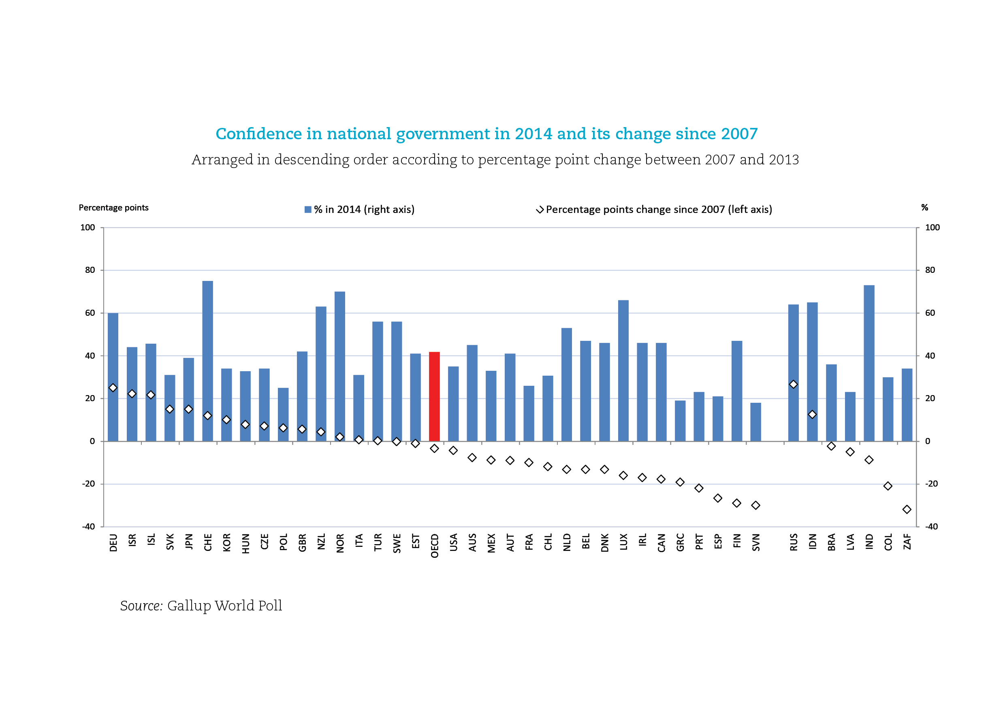
… there has been a decline in confidence in government since the global crisis
Confidence in national governments

Slide 16
How Do We Support POlicymakers?

Slide 17
Some of our areas of work
Budgeting and public expenditure
Public employment and management
Promoting integrity and fighting corruption
Regulatory policy
Digital Government
Strategic policymaking and coordination
Public sector innovation

Slide 18
Key pillars of our engagement
Communities
Committees, Working Parties and Networks, Conferences
OECD instruments
Principles and Recommendations to Council
Data and research
Surveys, thematic reports, Government at a Glance
Sharing practices and experience
Online platforms, OPSI, comparative studies
Tailored advice
Peer Reviews, Thematic reviews, Regional reviews

Slide 19
Policy communities
Committees and Working Parties for policymakers:
Regulation, Public Governance
Networks of senior officials:
Centres of Government, Senior Budget Officials, Regulators, regional networks
Conferences and symposia:
Integrity Forum, Open Government, etc.

Slide 20
OECD instruments: recommendations adopted over the last 5 years on public governance
Recommendation on gender equality
in public life (2015)
Recommendation on budgetary governance (2015)
Recommendation on digital government strategies
(2014)
Recommendation on the governance of critical risk
(2014)
Recommendation on effective
public investment
across levels of government
(2014)
Recommendation on regulatory policy and governance (2012)
Recommendation on Fighting Bid Rigging in Public Procurement (2012)
Quality, Integrity & Independence
International Open Data Charter *
(2015)
Recommendation on Principles for Public Governance of Public-Private Partnerships
(2012)
Recommendation on Principles for Transparency
& Integrity in Lobbying
(2010)
*developed with participation of OECD

Slide 21
Data and Research: Government at a Glance
Biennial publication: 2009, 2011, 2013, 2015 and 2017
50+ indicators covering the entire “production chain” of government activity
Output and outcome data; efficiency and effectiveness indicators
Includes all member and partner countries

Slide 22
Data and Research: Regulatory Policy Outlook
First evidence-based cross-country analysis of OECD countries’ progress to improve the way they regulate
Based on the 2015 Indicators of Regulatory Policy and Governance (iReg)
In-depth review of 3 key tools of regulatory policy: RIA, stakeholder engagement, ex post evaluation
Forward looking agenda for regulatory policy

Slide 23
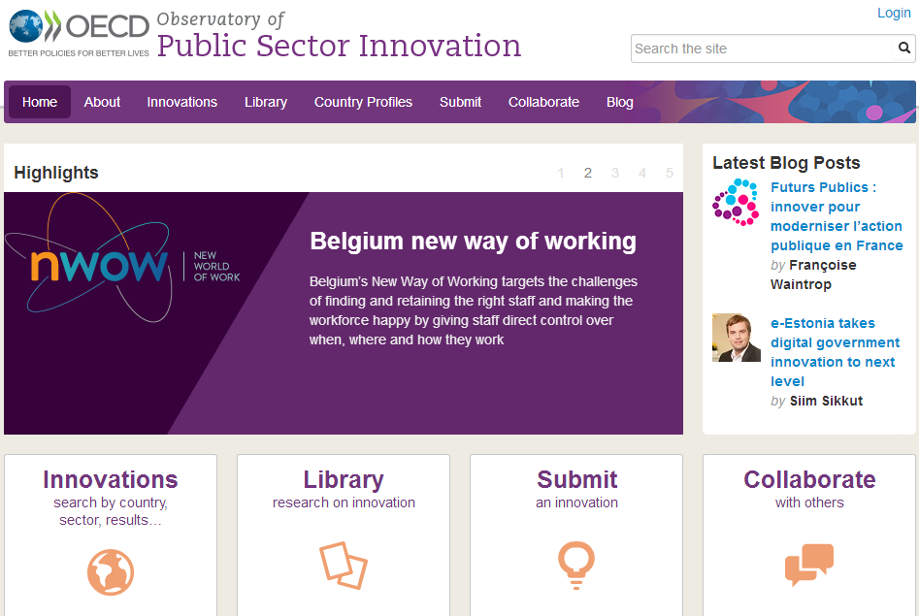
Sharing good practices: The case of OPSI
oe.cd/opsi
An interactive platform to share and collaborate
Designed by policy makers from 33 countries
More than 120 projects
Innovations from health, education, environment, social protection, public safety

Slide 24
Tailored advice: The case of Public Governance Reviews
Leadership and
co-ordination by the Centre of Government
Strategic planning and budgeting
Performance management, policy evaluation
Multilevel governance
Public sector integrity
Public sector procurement
Human resources management
Digital governance
Regulatory reform
Actionable recommenda- tions (+ imple- mentation support)
In-depth analysis
360° diagnostic
Overarching themes:

Slide 25
Thank you!
www.oecd.org/gov

