Slide 1

Evaluating Public Administration Research:
Applying a Behavioral Perspective to Public Management
Donald P. Moynihan

Slide 2
One new trend
Applying behavioral science to public administration
Use performance information use as an example
  Numeric literacy
  Power of comparison
  Distrust of data
  Anti public sector bias
  Motivated reasoning
  Negativity bias

Slide 3
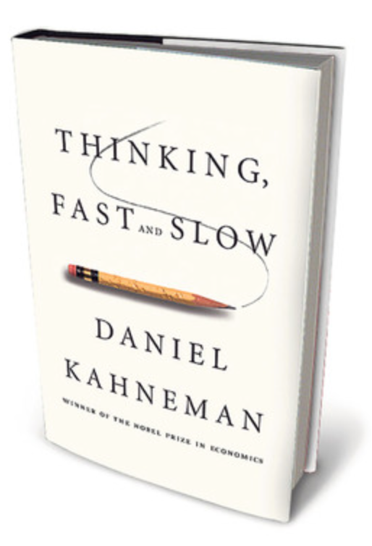
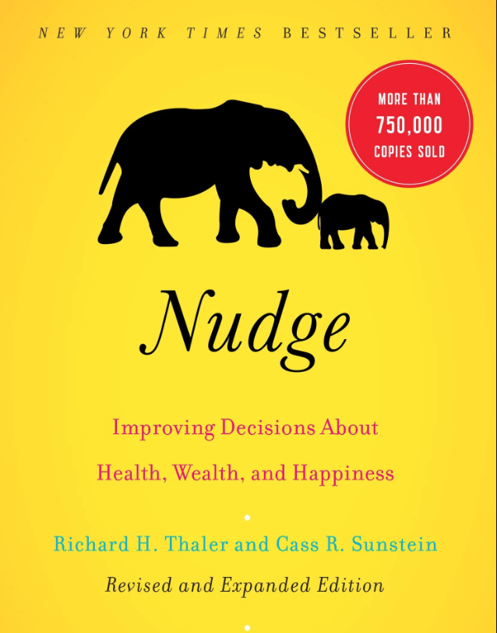

Notes:
We have heard a lot about biases in the last couple of years
Boom in behavioral science
(grand-daddy of them all was Herbert Simon – dealing with public administration)

Slide 4







Slide 5
Field of behavioral science
Starts from psychology – ideal for focus on cognition
Identified some biases relevant to policymaking:
  Confirmation bias
Little attention to public management
Notes:
There is a focus on numeric literacy, bit not about public sector numbers
As we shall see, dimensions of publicness matter: anti public sector bias, motivatied reasoning

Slide 6
Behavioral public administration
Focuses behavioral science to specific public management issues
Relies primarily on experiments

Slide 7
Why performance information use matters
Implies use of performance data about public action
  What do we really know about this?
  Mixed track record of performance management
  Not really sure how to do better
  Standard formula: improve the supply of data, or attach to incentives
  Can’t get far until we understand how people react to information
Notes:
Further: the quality of evidence begind one approach or the other is not evry good.

Slide 8

Performance information use is a cognitive processes
Need to understand what goes on inside our heads when we are given numbers

Slide 9

Performance information use is a cognitive processes
To deal with complexity, we use cognitive shortcuts
Sometimes these shortcuts are efficient
Sometimes they lead us to make bad decisions – they become biases
“It ain’t what you don’t know that gets you into trouble;
its what you know for sure that just ain’t so” – Mark Twain
Notes:
we might stick with the brand of beer that we are familiar with
saves us trying new things
We may

Slide 10
Control group – provides a baseline
Treatment – the idea being tested
Notes:
How randomization works
We should hae higher conidence in these sorts of results – reveal causal processes; that’s rare in performance management
Is there a difference in outcome between the treated and control group: is so should be because of treatment
People who might be unusual in some way should be evenly distributed across the treated and control groups

Slide 11
1. Numeric literacy: Do we even really like data…?
Public say they prefer statistical information over anecdote, but…
  Find anecdotal information more memorable, and more emotionally engaging
Left-most digit bias: round numbers are more compelling
Which school does better?
  School A: improved test scores from 6.1 to 6.9
  School B: improved test scores from 5.9-6.1

Slide 12
Implications of numeric literacy
Be realistic about capacities of citizens & policymakers
Use illustrative stories
Connect numbers to broader narratives

Slide 13
Implications of numeric literacy
Present changes graphically, not numerically
School B
School A – test score change

Slide 14
2. Power of comparison
Comparative data: metric compared to peer, past, or future
  More persuasive
  Comparison with peers most compelling
  Setting unrealistic targets lowers evaluation of good performance
Provision of comparative data (how you ranked compared to other schools) made principals more likely to download data
  Makes data more useful
  May be motivating

Slide 15
Implications of comparison
Use comparative metrics to explain and to motivate
Find suitable peers
Engage in benchmarking
Avoid unrealistic targets

Slide 16
3. Anti-public sector bias
“Citizens automatically and unconsciously associate public sector organizations with inefficiency, inflexibility and other pejoratives, and these automatic associations color their assessments of public sector performance” (Marvel 2016, 143).
In very different settings – US & Denmark – citizens rated public service providers lower than private even when given exactly same performance data

Slide 17
Implications of anti-public sector bias
Unclear: hide the role of the state or make it clearer
Complex in context where private actors play a big role delivering public investments
Play up public-private partnerships

Slide 18
4. Distrust of government data
Citizens trust self-reported public performance data less than data provided by a third party
This distrust increases as the task becomes more complex

Slide 19
Implications of distrust of data
Use third parties to collect and report on outcomes

Slide 20
5. Motivated reasoning
Ideological beliefs alter how we select, weigh, interpret and use performance data
We give credit to those we believe share out ideological beliefs and blame those from other parties, e.g. Hurricane Katrina
Swiss legislators more likely to make use of data when it fits with their ideological beliefs
Notes:
Ideological distance affects how performance data is used:
Agencies defined as liberal tended to receive lower performance scores, more scrutiny, more improvement plans than conservative peers (Lavertu, Lewis & Moynihan 2013)

Slide 21
Motivated reasoning
US: Democrats and Republican citizens chose different performance data to evaluate “Obamacare”
Exacerbates anti-public sector bias
  Conservative citizens and elected officials more likely to interpret same performance data negatively if told service provider was public rather than private
  Addition of more performance data did not debias elected official assessments

Slide 22

Affects who elected officials listen to
  Comments by teachers unions criticizing test scores reduced tendency by liberal elected officials to use the data, but not for conservative officials

Slide 23
Applying motivated reasoning: Basic concepts
How do different types of preferences relate to each other?
  Goal preferences: within a policy area, people care about different goals
    I think schools that perform better on student well-being rather than test scores are best
    Our goal preferences should guide how we evaluate public organizations
  Governance preferences: general beliefs about how government should be run, e.g., preference for public versus private provision
    I also prefer public schools over private
Notes:
Ideological distance affects how performance data is used:
Agencies defined as liberal tended to receive lower performance scores, more scrutiny, more improvement plans than conservative peers (Lavertu, Lewis & Moynihan 2013)

Slide 24
What happens when goal preferences clashes with governance preferences
Goal reprioritization:
  Partisans alter the importance they assign to different goals depending on what aligns with core partisan beliefs
  Governance preferences > goal expectations
    When given data showing private schools perform better on student well-being, I switch my goal expectation to test scores because it makes public schools look better
Notes:
Ideological distance affects how performance data is used:
Agencies defined as liberal tended to receive lower performance scores, more scrutiny, more improvement plans than conservative peers (Lavertu, Lewis & Moynihan 2013)

Slide 25
Illustrative survey experiment
988 Danish city councillors (out of 2445 → 40.5 %).
Asked to evaluate performance information regarding academic achievements and student well-being at two schools: schools either do better on one goal or the other
Asked about preference for public or private service provisions

Slide 26
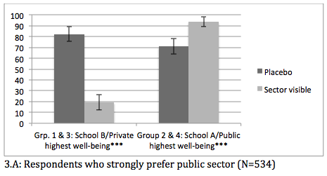
Pro-public group: Proportions who base evaluation on well-being
Notes:
When respondents who strongly prefer the public sector are presented with this data but without sector information, 82 percent select school B as best performing. However, when told that the school is private, only 19 percent select this school as best performing. Simply revealing that the provider of the school is private causes many elected officials to set aside their goal expectations for student well-being. In order to justify a desired conclusion (that a public school performs better than a private one), decision-makers reprioritize their evaluative criteria by lowering the importance they place on student well-being while redirecting the perceived importance to academic achievement instead. And similarly, the tendency to find well-being important becomes even stronger when a public school is shown to perform well on student well-being and less well on academic achievements. Thus, in group 4, no less than 94 percent of those who strongly prefer the public sector point to the public school as the school that performed best, compared to 71 percent who were not told what sector the school was in group 2.

Slide 27
Implications of motivated reasoning
Performance data does not engender consensus where there is are strong prior beliefs– may actually harden disagreement
Policymakers may ignore data on performance on issues they say they care about if it challenges core beliefs
Policymakers “shop around” for data to justify core beliefs
Present data as neutrally as possible
  Reflects competing values
  Shows good and bad news
  Get advance commitment from all parties on goals

Slide 28
6. Negativity bias
Loss aversion
  People are more motivated by loss than equivalent gain
  We see this in how media chooses to cover public sector

Slide 29
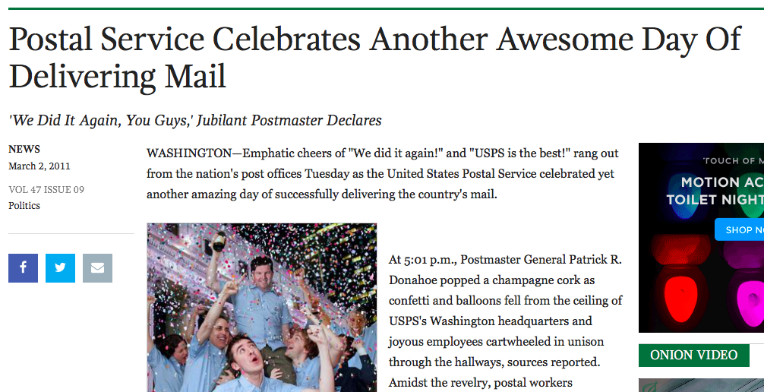
Onion headline

Slide 30
Negativity bias
We are more interested in and responsive to data that is labeled as low performance

Slide 31
Negativity bias
Citizens evaluate services more negatively if the same performance data is presented in a negative terms (rates of dissatisfaction) rather than a positive (rates of satisfaction)
Asymmetry in how we give credit to good and bad performance
  Public more critical of UK local political incumbents and less likely to vote for them when performance data is labeled as poor, but do not provide equivalent credit when performance is good

Slide 32
Negativity bias: holding leaders accountable
Local elected officials asked to attribute responsibility for outcomes of schools to school principals
Performance data increases responsibility attribution in cases of low performance

Slide 33
Implications of negativity bias
”We should have excellence in government” - President Trump’s son-in-law
That’s not how our brains are wired
Manage to avoid failure rather than excellence
Present results in terms of levels of achievement, not failure
Use data to identify risk and problem-solve

Slide 34
Conclusion
Welcome comments and questions
How do these findings apply to your area of work?
Web: http://www.lafollette.wisc.edu/faculty-staff/faculty/donald-moynihan
Email: dmoynihan@lafollette.wisc.edu
Twitter: @donmoyn

Slide 35
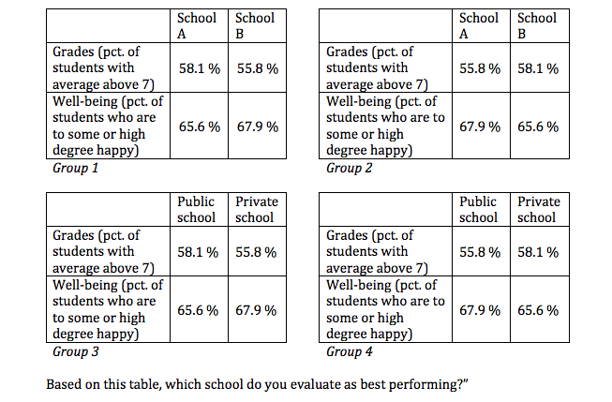
Design
- Two placebo grps (A/B).
- Two stimulus grps (pub/priv).
    Trigger ideologically based attitudes towards public/private welfare delivery.
- Ambiguity: Forced to prioritize.

Slide 36
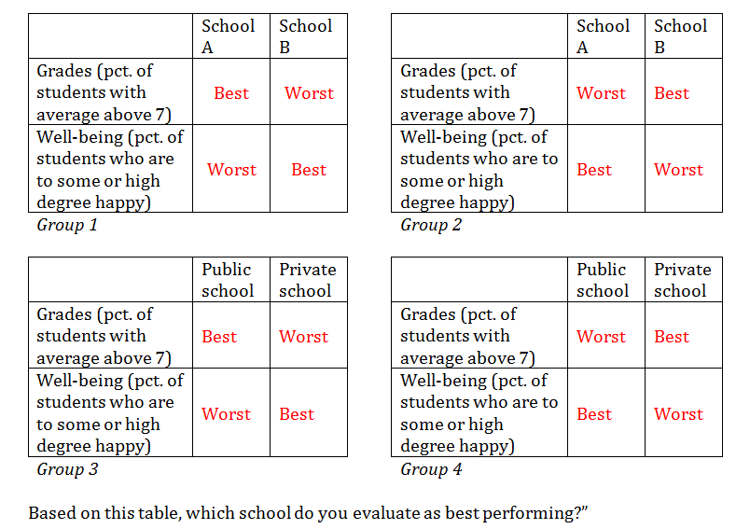
Design
- Two placebo grps (A/B).
- Two stimulus grps (pub/priv).
    Trigger ideologically based attitudes towards public/private welfare delivery.
- Ambiguity: Forced to prioritize.
- Divide respondents into three groups: agnostic, pro-public, pro-private

Slide 37
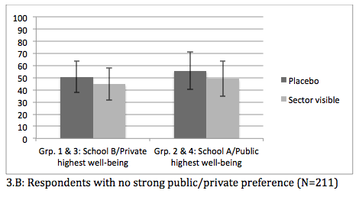
No difference among those without governance preferences in how they use performance information when service provider revealed

